Slide 1
Searching – Part 2
Hashing

Slide 2
Hash Tables
The implementation of hash tables is called hashing.
Hashing is a technique used for performing insertions, deletions and finds in constant average time (i.e. O(1))
This data structure, however, is not efficient in operations that require any ordering information among the elements, such as findMin, findMax and printing the entire table in sorted order.

Slide 3
General Idea
The ideal hash table structure is an array of some fixed size, containing the items.
A stored item needs to have a data member, called key, that will be used in computing the index value for the item.
  Key could be an integer, a string, etc
  e.g. a name or Id that is a part of a large employee structure
The size of the array is TableSize.
The items that are stored in the hash table are indexed by values from 0 to TableSize – 1.
Each key is mapped into some number in the range 0 to TableSize – 1.
The mapping is called a hash function.

Slide 4
Example
Hash
Table
0
1
Items
Hash
Function
2
john 25000
3
john 25000
phil 31250
key
4
phil 31250
dave 27500
5
mary 28200
6
dave 27500
7
mary 28200
key
8
9

Slide 5
Searching by using Hash Table
To search for a data record by hashing:
An array must be declared that will hold the hash table.
All locations in the array must be initialized to show that they are empty.
All data records must be inserted into the hash table by using a hash function.
Finally, we can retrieve data records by using the hash function that was employed in the insertion step.

Slide 6
Hash Function
The hash function:
  must be simple to compute.
  must distribute the keys evenly among the cells.
If we know which keys will occur in advance we can write perfect hash functions, but we don’t.

Slide 7
Hash function
Problems:
Keys may not be numeric.
Number of possible keys is much larger than the space available in table.
Different keys may map into same location
  Hash function is not one-to-one => collision.
  If there are too many collisions, the performance of the hash table will suffer dramatically.

Slide 8
Hash Functions
If the input keys are integers then simply Key mod TableSize is a general strategy.
  Unless key happens to have some undesirable properties. (e.g. all keys end in 0 and we use mod 10)
If the keys are strings, hash function needs more care.
  First convert it into a numeric value.

Slide 9
Some Hash Functions
Truncation:
  e.g. 123456789 map to a table of 1000 addresses by picking 3 digits of the key. 123456789 → 589
Folding:
  e.g. 123|456|789: add them and take mod.
Key mod N:
  N is the size of the table, better if it is prime.
  e.g. Table size should be 997 or 1009 instead of 1000 or 1024. Powers of 2 and 10 are also poor choices.
Squaring:
  Square the key and then truncate.

Slide 10
Hash Function 1
Add up the ASCII values of all characters of the key.
int hash(char *key, int tableSize)
{
int hasVal = 0;
int i;
for (i = 0; key[i]!=‘\0’; i++)
hashVal += key[i];
return hashVal % tableSize;
}
Simple to implement and fast.
However, if the table size is large, the function does not distribute the keys well.
  e.g. Table size =10000, key length <= 8, the hash function can assume values only between 0 and 1016

Slide 11
Hash Function 2
Examine only the first 3 characters of the key.
int hash (char *key, int tableSize)
{
return (key[0]+27 * key[1] + 729*key[2]) % tableSize;
}
In theory, 26 * 26 * 26 = 17576 different words can be generated. However, English is not random, only 2851 different combinations are possible.
Thus, this function although easily computable, is also not appropriate if the hash table is reasonably large.

Slide 12
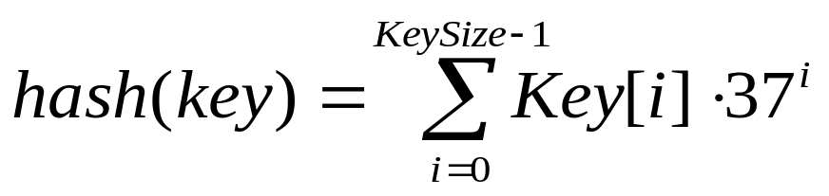
Hash Function 3
int hash (char *key, int tableSize)
{
int hashVal = 0;
int i;
for (i = 0; key[i] != ‘\0’; i++)
hashVal = hashVal + key[i] * pow(37,i);
hashVal = hashVal % tableSize;
if (hashVal < 0) /* in case overflows occurs */
hashVal += tableSize;
return hashVal;
};

Slide 13
Hash function for strings:
98
108
105
key[i]
key
a
l
i
0 1 2
i
KeySize = 3;
hash(“ali”) = (98 * 1 + 108*37 + 105*37²) % 10,007 = 7741
0
hash
function
1
2
“ali”
……
ali
7741
……
10,006 (TableSize-1)

Slide 14
Collision Resolution
When an element is inserted, if it hashes to the same value as an already inserted element, then we have a collision and need to resolve it.
There are several methods for dealing with this:
  Separate chaining
  Open addressing
    Linear Probing
    Quadratic Probing
    Double Hashing
    Random Probing

Slide 15
Separate Chaining
The idea is to keep a list of all elements that hash to the same value.
  If a collision occurs, the array element points to the first node of the list of items.
  A new item is inserted to the end of the list.
Advantages:
  Better space utilization for large items.
  Simple collision handling: searching linked list.
  Overflow: we can store more items than the hash table size.
  Deletion is quick and easy: deletion from the linked list.

Slide 16
Example
Keys: 0, 1, 4, 9, 16, 25, 36, 49, 64, 81
hash(key) = key % 10.
0
0
1
1
81
2
3
4
4
64
5
25
6
16
36
7
8
9
9
49

Slide 17
Operations
Initialization: all entries are set to EMPTY
Find:
  locate the cell using hash function.
  sequential search on the linked list in that cell.
Insertion:
  Locate the cell using hash function.
  If the cell is empty, insert it.
  Otherwise, if the item does not exist, insert it as the last item in the list.
Deletion:
  Locate the cell using hash function.
  Delete the item from the linked list.

Slide 18
Analysis of Separate Chaining
Collisions are very likely.
Cost of insertion, deletion, and retrieval of a record is proportional to the length of the linked list.
If list is long, cost increases and becomes similar to sequential search.

Slide 19
Summary
The analysis shows us that the table size is not really important, but the load factor (N/TableSize) is.
TableSize should be as large as the number of expected elements in the hash table.
  To keep load factor around 1.
TableSize should be prime for even distribution of keys to hash table cells.

Slide 20
Hashing: Open Addressing

Slide 21
Collision Resolution with
Open Addressing
Separate chaining has the disadvantage of using linked lists.
  Requires the implementation of a second data structure.
In an open addressing hashing system, all the data go inside the table.
  Thus, a bigger table is needed.
    Generally the load factor should be below 0.5.
  If a collision occurs, alternative cells are tried until an empty cell is found.

Slide 22
Open Addressing
More formally:
  Cells h₀(x), h₁(x), h₂(x), …are tried in succession where h_{i}(x) = (hash(x) + f(i)) mod TableSize, with f(0) = 0.
  The function f is the collision resolution strategy.
There are three common collision resolution strategies:
  Linear Probing
  Quadratic probing
  Double hashing

Slide 23
Linear Probing
In linear probing, collisions are resolved by sequentially scanning an array (with wraparound) until an empty cell is found.
  i.e. f is a linear function of i, typically f(i)= i.
Example:
  Insert items with keys: 89, 18, 49, 58, 9 into an empty hash table.
  Table size is 10.
  Hash function is hash(x) = x mod 10.
    f(i) = i;

Slide 24
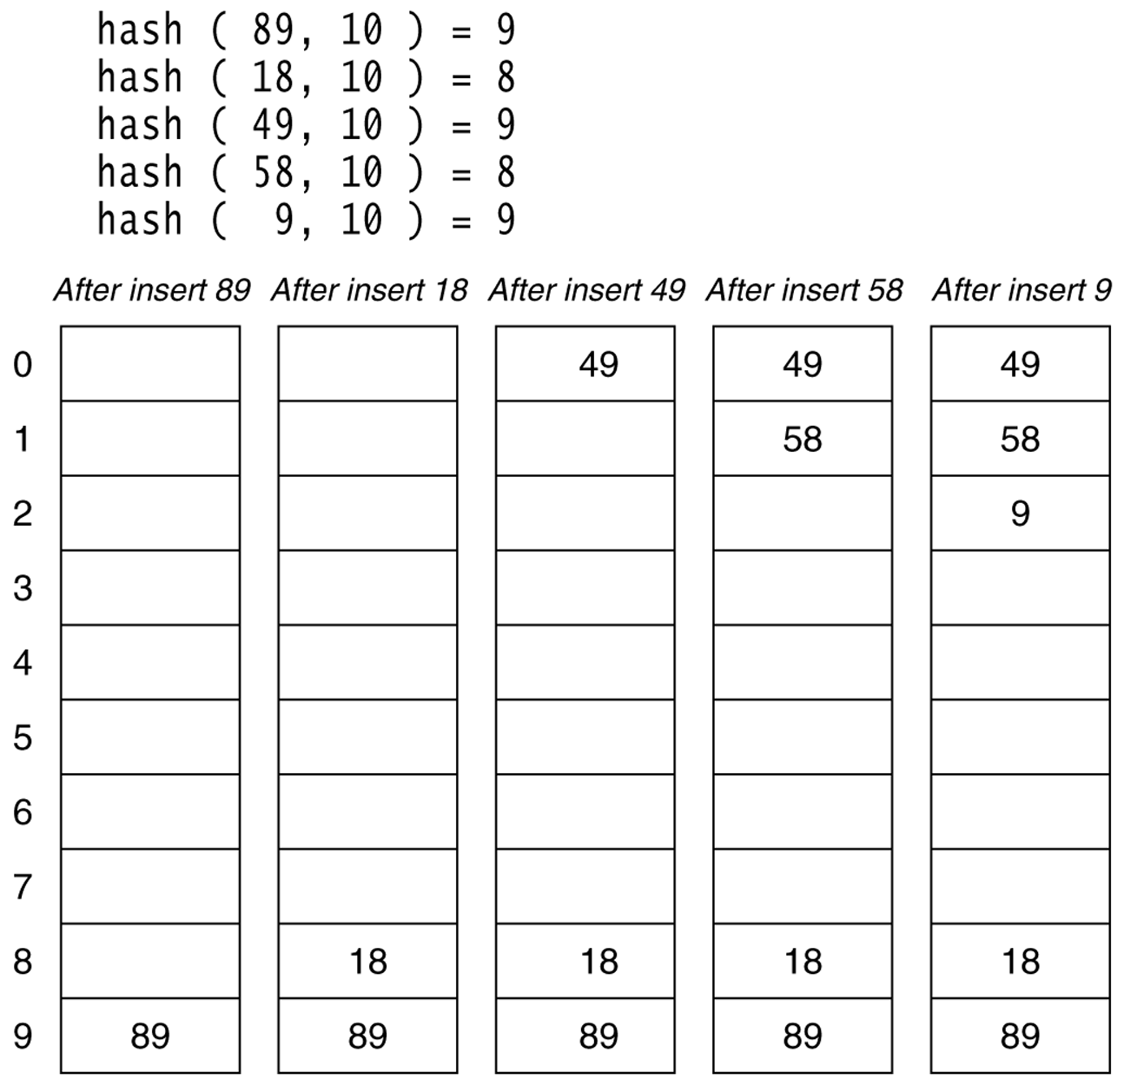
Figure 20.4
Linear probing hash table after each insertion

Slide 25
Find and Delete
The find algorithm follows the same probe sequence as the insert algorithm.
  A find for 58 would involve 4 probes.
  A find for 19 would involve 5 probes.
We must use lazy deletion (i.e. marking items as deleted)
  Standard deletion (i.e. physically removing the item) cannot be performed.
  e.g. remove 89 from hash table.

Slide 26
Clustering Problem
As long as table is big enough, a free cell can always be found, but the time to do so can get quite large.
Worse, even if the table is relatively empty, blocks of occupied cells start forming.
This effect is known as primary clustering.
Any key that hashes into the cluster will require several attempts to resolve the collision, and then it will add to the cluster.

Slide 27
Linear Probing – Analysis -- Example
What is the average number of probes for a successful search and an unsuccessful search for this hash table?
  Hash Function: h(x) = x mod 11
Successful Search:
  20: 9 -- 30: 8 -- 2 : 2 -- 13: 2, 3 -- 25: 3,4
  24: 2,3,4,5 -- 10: 10 -- 9: 9,10, 0
Avg. Probe for SS = (1+1+1+2+2+4+1+3)/8=15/8
Unsuccessful Search:
  We assume that the hash function uniformly distributes the keys.
  0: 0,1 -- 1: 1 -- 3: 3,4,5,6
  4: 4,5,6 -- 5: 5,6 -- 6: 6 -- 7: 7 -- 8: 8,9,10,0,1
Avg. Probe for US =
(2+1+4+3+2+1+1+5)/8=19/8
0 | 9
1
2 | 2
3 | 13
4 | 25
5 | 24
6
7
8 | 30
9 | 20
10 | 10

Slide 28
Quadratic Probing
Quadratic Probing eliminates primary clustering problem of linear probing.
Collision function is quadratic.
  The popular choice is f(i) = i².
If the hash function evaluates to h and a search in cell h is inconclusive, we try cells h + 1², h+2², … h + i².
  i.e. It examines cells 1,4,9 and so on away from the original probe.
Remember that subsequent probe points are a quadratic number of positions from the original probe point.

Slide 29
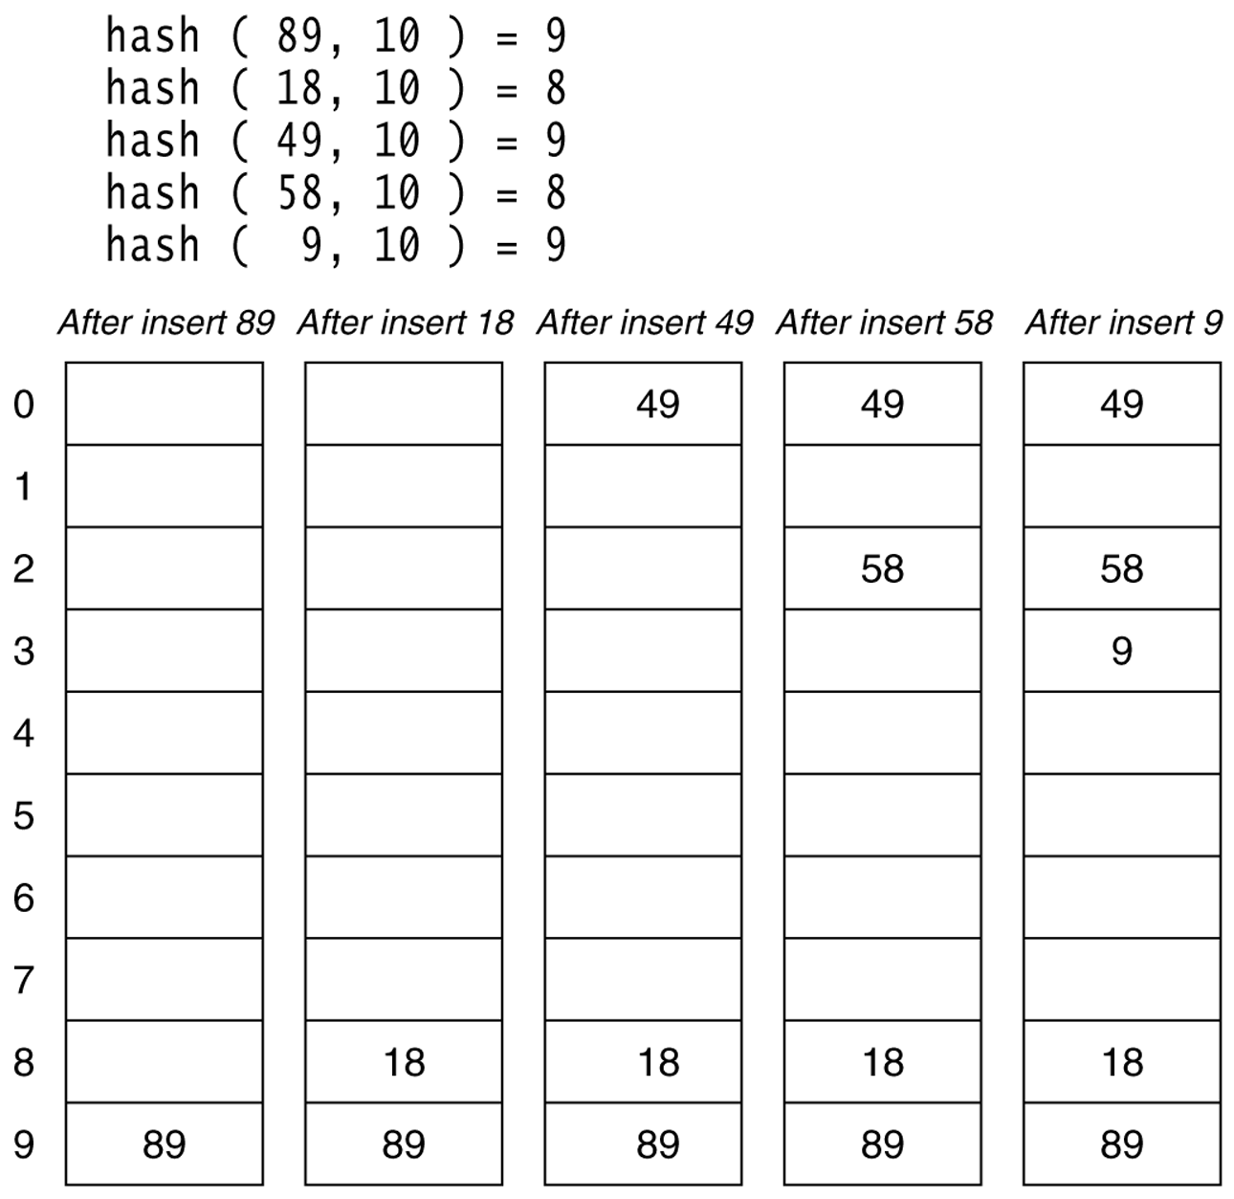
Figure 20.6
A quadratic probing hash table after each insertion (note that the table size was poorly chosen because it is not a prime number).

Slide 30
Quadratic Probing
Problem:
  We may not be sure that we will probe all locations in the table (i.e. there is no guarantee to find an empty cell if table is more than half full.)
  If the hash table size is not prime this problem will be much severe.
However, there is a theorem stating that:
  If the table size is prime and load factor is not larger than 0.5, all probes will be to different locations and an item can always be inserted.

Slide 31
Hash Table Implementation using Quadratic Probing
#define TableSize 997; // a prime number
typedef struct s{
char id[11];
char name[20];
float gano;
}STUDENT;
STUDENT H[TableSize]; // Global Hash Table
void initializeHashTable(){
int i;
for (i=0; i<TableSize; i++)
strcpy(H[i].id,"");
}

Slide 32
Hash Function
int hashFunction(char *key, int size){
int i,j,k,result;
// 48 is ASCII code of 0
i = key[10]-48; //last digit
j = key[9]-48; // 2nd digit from last
k = key[6]-48; // 5th digit from last
result = (k*100 + j*10 + i) % size;
return result;
}

Slide 33
Insertion function
void insert(STUDENT r){
int c,i,p,q;
p=hashFunction(r.id,TableSize);
c=0;
i=1; q = p;
while ((strcmp(H[p].id,"")!=0) &&
(strcmp(H[p].id,r.id)!=0) &&
(c <= TableSize/2)){
c++;
p = q + i * i;
i++;
if (p > TableSize-1)
p = p % TableSize;
}

Slide 34
Insertion function (cont.)
//if empty position is found, insert r
if (strcmp(H[p].id,"")==0){
strcpy(H[p].id, r.id);
strcpy(H[p].name, r.name);
H[p].gano = r.gano;
}
else if (strcmp(H[p].id, r.id)==0)
printf("Error, the same student cannot
appear twice\n");
else
printf("Overflow, counter has reached its
limit\n");
}

Slide 35
Search function
Very similar to insertion function.
How can you implement it?

Slide 36
Theorem
If quadratic probing is used, and the table size is prime, then a new element can always be inserted if the table is at least half empty.

Slide 37
Some Considerations
What happens if load factor gets too high?
  Dynamically expand the table as soon as the load factor reaches 0.5, which is called rehashing.
  Always double to a prime number.
  When expanding the hash table, reinsert the new table by using the new hash function.

Slide 38
Analysis of Quadratic Probing
Although quadratic probing eliminates primary clustering, elements that hash to the same location will probe the same alternative cells. This is known as secondary clustering.
Techniques that eliminate secondary clustering are available.
  the most popular is double hashing.

Slide 39
Double Hashing
A second hash function is used to drive the collision resolution.
  f(i) = i * hash₂(x)
We apply a second hash function to x and probe at a distance hash₂(x), 2*hash₂(x), … and so on.
The function hash₂(x) must never evaluate to zero.
  e.g. Let hash₂(x) = x mod 9 and try to insert 99 in the previous example.
A function such as hash₂(x) = R – ( x mod R) with R a prime smaller than TableSize will work well.
  e.g. try R = 7 for the previous example.(7 - x mode 7)

Slide 40
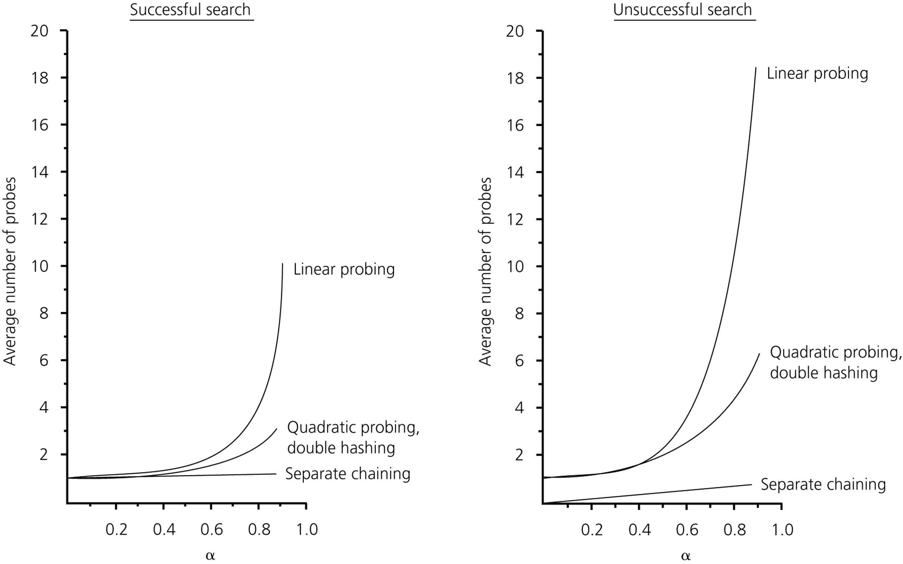
The relative efficiency of four collision-resolution methods

Slide 41
Hashing Applications
Compilers use hash tables to implement the symbol table (a data structure to keep track of declared variables).
Game programs use hash tables to keep track of positions it has encountered (transposition table)
Online spelling checkers.

Slide 42
Summary
Hash tables can be used to implement the insert and find operations in constant average time.
  it depends on the load factor.
  if no collision, insert and find are O(1) algorithms.
It is important to have a prime TableSize and a correct choice of load factor and hash function.
For separate chaining the load factor should be close to 1.
For open addressing load factor should not exceed 0.5 unless this is completely unavoidable.
  Rehashing can be implemented to grow (or shrink) the table.

